Slide 1
Jubilee: A Week of Annual Weeks - Calendar
 | Annual Week | 1 | 2 | 3 | 4 | 5 | 6 | 7
 | Annual Week 1 | Jubilee/Year 1 | Year 2 | Year 3 | Year 4 | Year 5 | Year 6 | Sabbath Year
 | Annual Week 2 | Year 1 | Year 2 | Year 3 | Year 4 | Year 5 | Year 6 | Sabbath Year
 | Annual Week 3 | Year 1 | Year 2 | Year 3 | Year 4 | Year 5 | Year 6 | Sabbath Year
 | Annual Week 4 | Year 1 | Year 2 | Year 3 | Year 4 | Year 5 | Year 6 | Sabbath Year
 | Annual Week 5 | Year 1 | Year 2 | Year 3 | Year 4 | Year 5 | Year 6 | Sabbath Year
 | Annual Week 6 | Year 1 | Year 2 | Year 3 | Year 4 | Year 5 | Year 6 | Sabbath Year
 | Annual Week 7 | Year 1 | Year 2 | Year 3 | Year 4 | Year 5 | Year 6 | Sabbath Year
 | Annual Week 1 | Jubilee/Year 1 | Year 2 | Year 3 | Year 4 | Year 5 | Year 6 | Sabbath Year
Week of Annual Weeks

Slide 2
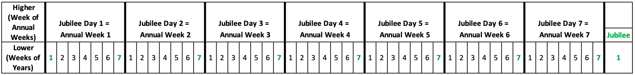
The Jubilee Week Time-Line

Slide 3
Feast of Weeks (Pentecost): A Week of Daily Weeks - Calendar
 | Daily Week | 1 | 2 | 3 | 4 | 5 | 6 | 7
 | Daily Week 1 | Day 1* | Day 2 | Day 3 | Day 4 | Day 5 | Day 6 | Weekly Sabbath
 | Daily Week 2 | Day 1 | Day 2 | Day 3 | Day 4 | Day 5 | Day 6 | Weekly Sabbath
 | Daily Week 3 | Day 1 | Day 2 | Day 3 | Day 4 | Day 5 | Day 6 | Weekly Sabbath
 | Daily Week 4 | Day 1 | Day 2 | Day 3 | Day 4 | Day 5 | Day 6 | Weekly Sabbath
 | Daily Week 5 | Day 1 | Day 2 | Day 3 | Day 4 | Day 5 | Day 6 | Weekly Sabbath
 | Daily Week 6 | Day 1 | Day 2 | Day 3 | Day 4 | Day 5 | Day 6 | Weekly Sabbath
 | Daily Week 7 | Day 1 | Day 2 | Day 3 | Day 4 | Day 5 | Day 6 | Weekly Sabbath
 | Daily Week | Pentecost/Day 1 | Day 2 | Day 3 | Day 4 | Day 5 | Day 6 | Weekly Sabbath
Week of Daily Weeks
*Note that, unlike the Jubilee cycle, the first day of the Feast of Weeks is NOT a holy day. INSTEAD, the Wave Sheaf offering occurs.

Slide 4
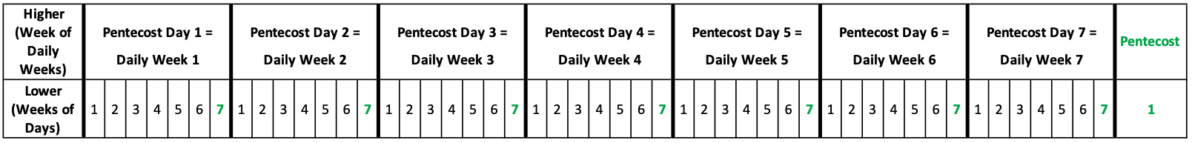
The Pentecost Week Time-Line

Slide 5
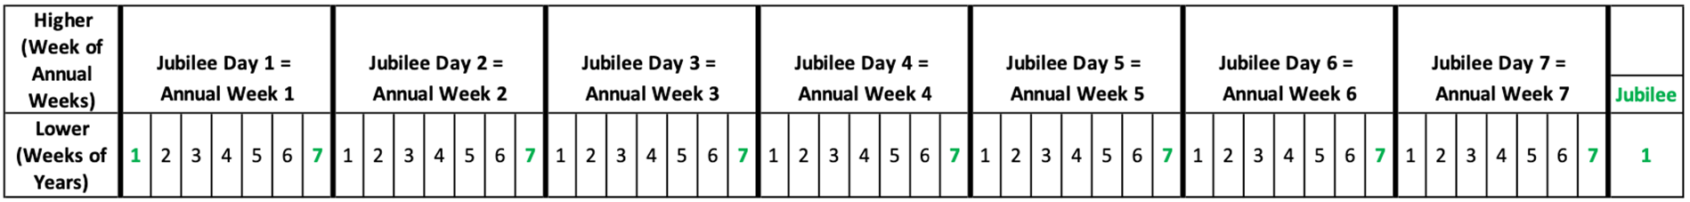
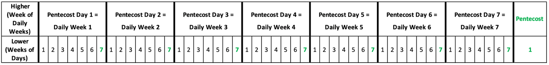
The SIMILARITY of Jubilee & Feast of Weeks Cycles

Slide 6
Some DIFFERENCES of Jubilee & Feast of Weeks Cycles
The Jubilee that occurs at the beginning of the Jubilee cycle (which is the concluding Jubilee of the previous cycle), has no sabbath correspondence at the beginning of the Feast of Weeks Cycle
HOWEVER, the Feast of Weeks cycle begins with the Wave Sheaf Offering
The Jubilee cycle is CONTINUOUS, but the Feast of Weeks cycle only occurs for 50 days out of each year – The Feast of Weeks cycle is FINITE, i.e. it has a beginning and an end

Slide 7
At Any Point in Time…
We are in multiple cycles of weeks at different levels.
Today is May 20, 2021:
Day 5 (Thursday) of the daily week
Year 5 of the annual week*
4th annual week of the Jubilee weeks*
69th Jubilee week*
6th millennial day of the millennial week
*Illustrative purposes only!

