Slide 1
The Week & Sabbath on The Calendar
Day 1 Sunday | Day 2 Monday | Day 3 Tuesday | Day 4 Wednesday | Day 5 Thursday | Day 6 Friday | Day 7 Saturday Sabbath
1 | 2 | 3 | 4 | 5 | 6 | 7
8 | 9 | 10 | 11 | 12 | 13 | 14
15 | 16 | 17 | 18 | 19 | 20 | 21
22 | 23 | 24 | 25 | 26 | 27 | 28
29 | 30 | 31

Slide 2
Annual Sabbaths for The Land
For six years you are to sow your fields and harvest the crops, but during the seventh year let the land lie unplowed and unused. Then the poor among your people may get food from it, and the wild animals may eat what is left. Do the same with your vineyard and your olive grove. Exodus 23:10-11 NIV. See Also: Leviticus 25:1–7

Slide 3
Annual Sabbath Release for Debtors
At the end of every seven years you must cancel debts. This is how it is to be done: Every creditor shall cancel any loan they have made to a fellow Israelite. They shall not require payment from anyone among their own people, because the Lord’s time for canceling debts has been proclaimed. You may require payment from a foreigner, but you must cancel any debt your fellow Israelite owes you. However, there need be no poor people among you, for in the land the Lord your God is giving you to possess as your inheritance, he will richly bless you, if only you fully obey the Lord your God and are careful to follow all these commands I am giving you today. For the Lord your God will bless you as he has promised, and you will lend to many nations but will borrow from none. You will rule over many nations but none will rule over you. Deuteronomy 15:1–6

Slide 4
Annual Sabbath Release for Slaves
If any of your people—Hebrew men or women—sell themselves to you and serve you six years, in the seventh year you must let them go free. Deuteronomy 15:12 NIV

Slide 5
Annual Weeks Calendar
Weeks | 1 | 2 | 3 | 4 | 5 | 6 | 7
Week 1 -> | Year 1 | Year 2 | Year 3 | Year 4 | Year 5 | Year 6 | Sabbath Year
Week 2 -> | Year 1 | Year 2 | Year 3 | Year 4 | Year 5 | Year 6 | Sabbath Year
Week 3 -> | Year 1 | Year 2 | Year 3 | Year 4 | Year 5 | Year 6 | Sabbath Year
Week 4 -> | Year 1 | Year 2 | Year 3 | Year 4 | Year 5 | Year 6 | Sabbath Year
Week 5 -> | Year 1 | Year 2 | Year 3 | Year 4 | Year 5 | Year 6 | Sabbath Year
Week 6 -> | Year 1 | Year 2 | Year 3 | Year 4 | Year 5 | Year 6 | Sabbath Year
Week 7 -> | Year 1 | Year 2 | Year 3 | Year 4 | Year 5 | Year 6 | Sabbath Year

Slide 6
The Jubilee
“Count off seven sabbath years—seven times seven years—so that the seven sabbath years amount to a period of forty-nine years. Then have the trumpet sounded everywhere on the tenth day of the seventh month; on the Day of Atonement sound the trumpet throughout your land. Consecrate the fiftieth year and proclaim liberty throughout the land to all its inhabitants. It shall be a jubilee for you; each of you is to return to your family property and to your own clan. The fiftieth year shall be a jubilee for you; do not sow and do not reap what grows of itself or harvest the untended vines. For it is a jubilee and is to be holy for you; eat only what is taken directly from the fields”. Leviticus 25:8-12 NIV

Slide 7
Jubilee: A Week of Annual Weeks - Calendar
 | Annual Week | 1 | 2 | 3 | 4 | 5 | 6 | 7
 | Annual Week 1 | Jubilee/Year 1 | Year 2 | Year 3 | Year 4 | Year 5 | Year 6 | Sabbath Year
 | Annual Week 2 | Year 1 | Year 2 | Year 3 | Year 4 | Year 5 | Year 6 | Sabbath Year
 | Annual Week 3 | Year 1 | Year 2 | Year 3 | Year 4 | Year 5 | Year 6 | Sabbath Year
 | Annual Week 4 | Year 1 | Year 2 | Year 3 | Year 4 | Year 5 | Year 6 | Sabbath Year
 | Annual Week 5 | Year 1 | Year 2 | Year 3 | Year 4 | Year 5 | Year 6 | Sabbath Year
 | Annual Week 6 | Year 1 | Year 2 | Year 3 | Year 4 | Year 5 | Year 6 | Sabbath Year
 | Annual Week 7 | Year 1 | Year 2 | Year 3 | Year 4 | Year 5 | Year 6 | Sabbath Year
 | Annual Week 1 | Jubilee/Year 1 | Year 2 | Year 3 | Year 4 | Year 5 | Year 6 | Sabbath Year
Week of Annual Weeks

Slide 8
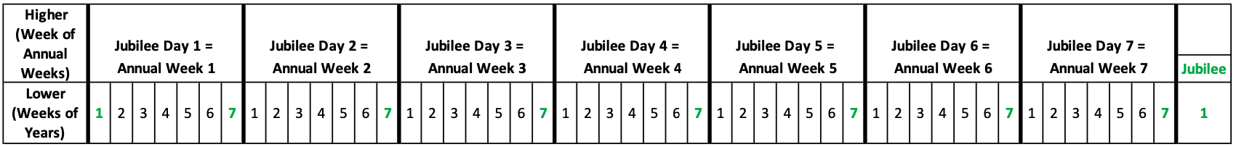
Jubilee: A Week of Annual Weeks - Levels

Slide 9
Feast of Weeks/Pentecost
From the day after the Sabbath, the day you brought the sheaf of the wave offering, count off seven full weeks. Count off fifty days up to the day after the seventh Sabbath, and then present an offering of new grain to the Lord. Leviticus 23:15-16 NIV

Slide 10
Feast of Weeks/Pentecost: A Week of Daily Weeks - Calendar
 | Daily Week | 1 | 2 | 3 | 4 | 5 | 6 | 7
 | Daily Week 1 | Day 1* | Day 2 | Day 3 | Day 4 | Day 5 | Day 6 | Weekly Sabbath
 | Daily Week 2 | Day 1 | Day 2 | Day 3 | Day 4 | Day 5 | Day 6 | Weekly Sabbath
 | Daily Week 3 | Day 1 | Day 2 | Day 3 | Day 4 | Day 5 | Day 6 | Weekly Sabbath
 | Daily Week 4 | Day 1 | Day 2 | Day 3 | Day 4 | Day 5 | Day 6 | Weekly Sabbath
 | Daily Week 5 | Day 1 | Day 2 | Day 3 | Day 4 | Day 5 | Day 6 | Weekly Sabbath
 | Daily Week 6 | Day 1 | Day 2 | Day 3 | Day 4 | Day 5 | Day 6 | Weekly Sabbath
 | Daily Week 7 | Day 1 | Day 2 | Day 3 | Day 4 | Day 5 | Day 6 | Weekly Sabbath
 | Daily Week | Pentecost/Day 1 | Day 2 | Day 3 | Day 4 | Day 5 | Day 6 | Weekly Sabbath
Week of Daily Weeks
*Note that, unlike the Jubilee cycle, the first day of the Feast of Weeks is NOT a holy day. INSTEAD, the Wave Sheaf offering occurs.

Slide 11
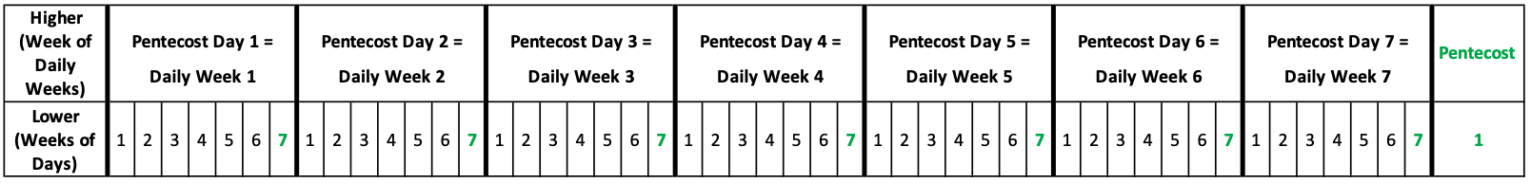
Feast of Weeks: A Week of Daily Weeks - Levels

Slide 12
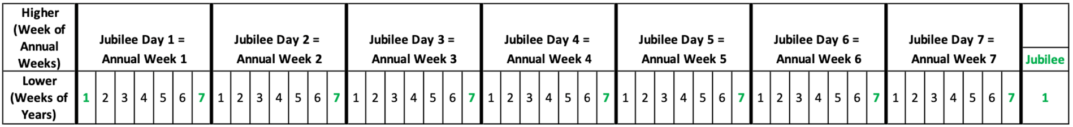
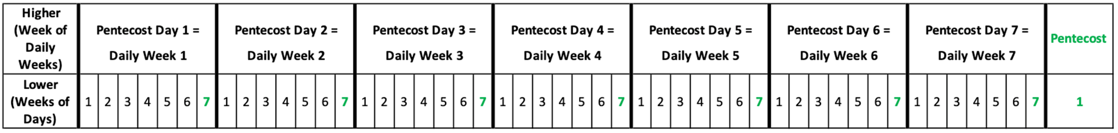
The SIMILARITY of Jubilee & Feast of Weeks Cycles

Slide 13
Some DIFFERENCES of Jubilee & Feast of Weeks Cycles
The Jubilee that occurs at the beginning of the Jubilee cycle (which is the concluding Jubilee of the previous cycle), has no sabbath correspondence at the beginning of the Feast of Weeks Cycle
HOWEVER, the Feast of Weeks cycle begins with the Wave Sheaf Offering
The Jubilee cycle is CONTINUOUS, but the Feast of Weeks cycle only occurs for 50 days out of each year – The Feast of Weeks cycle is FINITE, i.e. it has a beginning and an end

Slide 14
Millennial Week
But do not forget this one thing, dear friends: With the Lord a day is like a thousand years, and a thousand years are like a day. 2 Peter 3:8 NIV
Is there a week of 6 millenniums, followed by the Sabbath millennium? Revelation 20:1-6
Millennial Week
Millennium 1 | Millennium 2 | Millennium 3 | Millennium 4 | Millennium 5 | Millennium 6 | Millennial Sabbath

Slide 15
At Any Point in Time…
We are in multiple cycles of weeks at different levels.
Today is May 20, 2021:
Day 5 (Thursday) of the daily week
Year 5 of the annual week*
4th annual week of the Jubilee weeks*
6th millennial day of the millennial week
*Illustrative purposes only!

Slide 16
Lessons of the Weekly Sabbath Cycles - Recap
The Sabbath defines, encapsulates, contains, is a demarcation for the week. They are inseparable.
Repeat, ongoing, continuous, contiguous.
7 completes a cycle, 8 begins the next cycle or (Nx7)+1 = new beginning.
Exist on multiple layers, levels, processes, cycles, dispensations, octaves (e.g. daily weeks, annual weeks, daily weeks of weeks, annual weeks of weeks, millenniums, etc).
The levels overlap and are connected through relationships – the framework of the framework.
What’s Missing? – The actual processes contained within the weeks.

